Slide 1

Reduces coding effort and allows us to build production ready Object detections models
TensorFlow Object Detection API
https://github.com/tensorflow/models/tree/master/research/object_detection

Slide 2

Model Training in Object Detection API

Slide 3
1
Install Tensorflow Object Detection API
(One time)
Model Building using TensorFlow Object Detection API
2
Data Preparation in the required format
3
Choose model architecture
e.g SSD, Faster RCNN etc
4
START MODEL TRAINING

Slide 4
Installation Documentation
https://github.com/tensorflow/models/blob/master/research/object_detection/g3doc/installation.md
1. Installing TensorFlow Object Detection API
One time (on Google Colab every time)

Slide 5
2.1
Data Annotations
(Using LabelImg)
2. Data Preparation
Involves 3 key steps
2.2
Create TFRecords
(Object detection API required format)
2.3
Label Mapping file

Slide 6
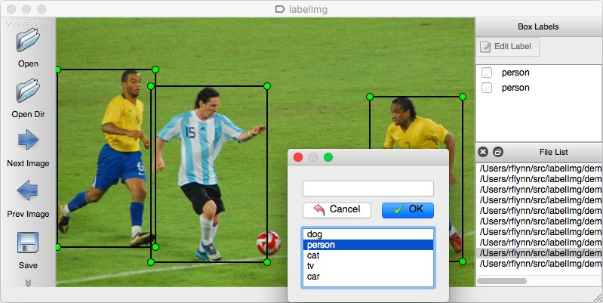
2.1 Data Annotations
Use LabelImg tool (https://github.com/tzutalin/labelImg) for data annotation. It will create an XML file for each image. This will act as input to Object Detection API.

Slide 7
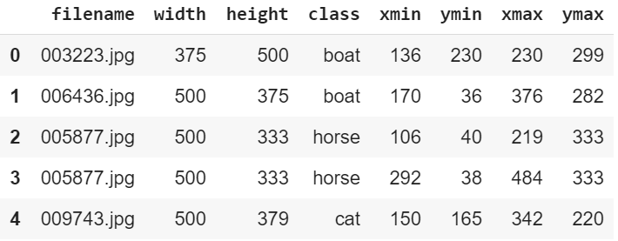
Image Annotations in PASCAL VOC Format
xml_to_csv.py script
CSV file information from all XML files
(XML file from LabelImg)
Key observations about CSV file:
It has 7 columns.
It will have one record for each object
An image can have multiple records in csv file if it has multiple objects
2.2 Creating tfrecord files
Multi-step process but steps are repeatable for every dataset

Slide 8
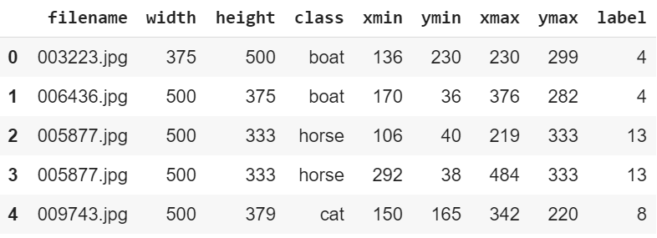
Image Annotations in PASCAL VOC Format
CSV file information from all XML files
(XML file from LabelImg)
Label encode ‘class’ with unique index (starting at 1)
2.2 Creating tfrecord files
Multi-step process but steps are repeatable for every dataset

Slide 9
Image Annotations in PASCAL VOC Format
CSV file information from all XML files
Label encode ‘class’ with unique index (starting at 1)
(XML file from LabelImg)
Training & Test tfrecord files
generate_tfrecord.py script
Training & Test CSV files
Split data between training & test
2.2 Creating tfrecord files
Multi-step process but steps are repeatable for every dataset

Slide 10
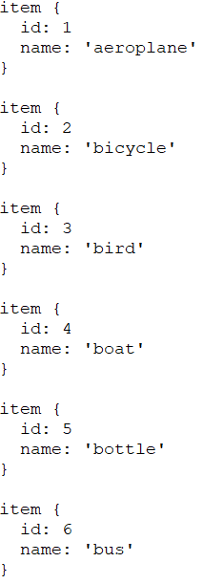
2.3 Creating Label Mapping file
Single file with ‘item’ dict with unique class ‘id’ and ‘name’. The ‘id’ should start from ‘1’. Make sure class name has quotes around it.

Slide 11
3.1
Decide on Model
e.g SSD vs Faster RCNN
3. Choose Model Architecture
API supports both Faster RCNN and SSD
3.2
Using Pre-trained Model
(Transfer Learning)
3.3
Model training Configuration

Slide 12
TensorFlow Object Detection API
provides several pre-trained models for us to start training
https://github.com/tensorflow/models/blob/master/research/object_detection/g3doc/detection_model_zoo.md
3.2 Transfer Learning : Pre-trained Model
Model Training

Slide 13
Model training information
Num of classes
Type of model
Layers
Losses
Training duration etc
…
Training data location …
tfrecord
Label map
Test Data location
tfrecord
Label map
…
Pre-trained model location
...
3.3 Model Training Configuration
What does Model config file contains?
Train & test tfrecord files
Label Map file
Pre-trained Model
Model Config file

Slide 14
TensorFlow Object Detection API
provides model training configuration files which can be fine tuned for our model training
https://github.com/tensorflow/models/tree/master/research/object_detection/samples/configs
3.3 Model Training Configuration
Model Training

Slide 15
Change num_classes parameter to number of classes in your dataset (e.g. 20 classes in pascal voc dataset)
For 'train_input_reader' change 'input_path' to filepath of train.record file.
For 'train_input_reader' change 'label_map_path' to filepath of pascal_voc.pbtxt file.
Repeat above two steps for 'eval_input_reader'.
Change fine_tune_checkpoint to filepath where pre-trained model.ckpt file is available e.g ssd_mobilenet_v1_coco_2018_01_28/model.ckpt
Change 'batch_size' accordingly to available memory.
Change 'num_steps' to indicate how long the training will done e.g. 200000. Removing this parameter means that you can train indefinitely.
3.3 Model Training Configuration
Key things to change in Sample file

Slide 16
Model training information
Num of classes
Type of model
Layers
Losses
Training duration etc
…
Training data location …
tfrecord
Label map
Test Data location
tfrecord
Label map
…
Pre-trained model location
...
Start training using train script in Object Detection API
Train & test tfrecord files
Saved model at iteration x
Saved model at iteration x
Saved model at iteration x
Label Map file
Training script will automatically save model every few hundred iterations. We can always restart training from the last saved model.
Pre-trained Model
Model Config file
4. Model Training

Slide 17
Saved model at iteration x
export_inference_graph.py available in Object Detection API
Frozen Model in Protocol Buffer and Saved Model format
Saved model at iteration x
Saved model at iteration x
5. Freezing Trained Model
Remove nodes which are not used during prediction e.g Loss, Gradient Descent etc

Slide 18
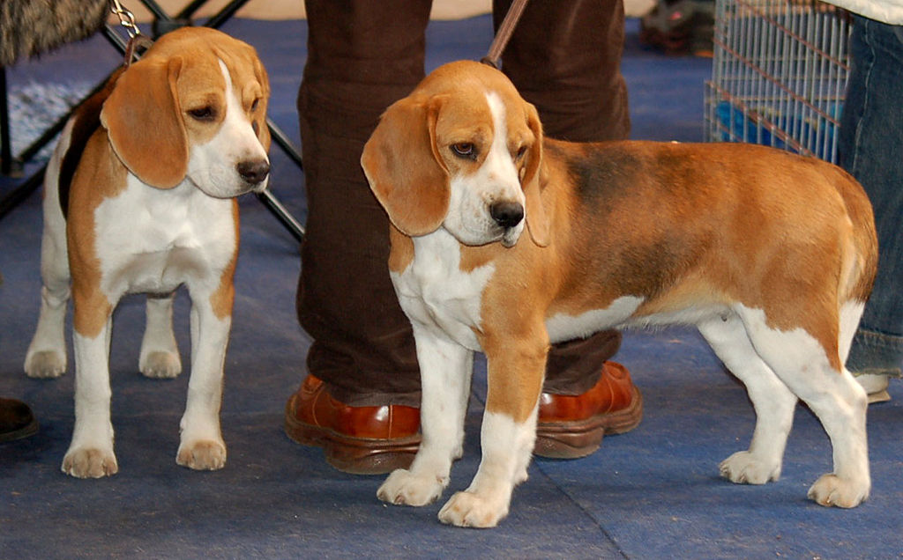
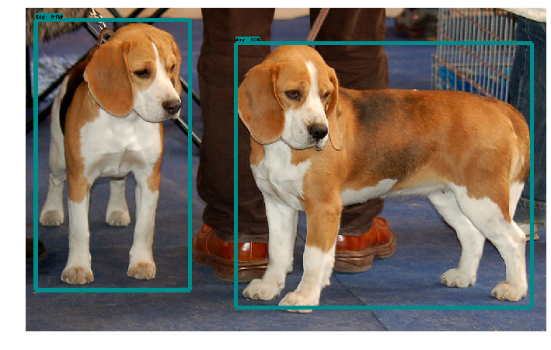
Frozen Model
6. Model Prediction
Object Detection API makes a notebook available for model prediction which can be used with any model trained with TensorFlow object detection APIc

Slide 19
2.1 Data Annotations
2.2 CSV File
Model Training E2E
Using TensorFlow Object Detection API
2.4 Label Mapping file
2.3 Tfrecord files
(Train & Test)
3.3 Model Configuration File
3.1 Choose Model Architecture
3.2 Download Pre-trained Model
(Transfer Learning)
5. Frozen Model
(Ready for Prediction)
1. Install TensorFlow Object Detection API
4. Model Training using training script
Saved Model
Saved Model
Saved Models

Slide 20
Building Object Detector
Exercise

